Slide 1
PersonALIZED Diversification of Search Results
Date: 2013/04/15
Author: David Vallet , Pablo Castells
Source: SIGIR’12
Advisor: Dr.Jia-ling, Koh
Speaker: Shun-Chen, Cheng

Slide 2
Outline
Introduction
Personalized Diversity
IA-Select、xQuAD
Personalized IA-Select
Personalized xQuAD
Evaluation
Experiment Results
Conclusions

Slide 3
Introduction
Search Personalization:
adapt the search result to a specific aspect that may interest the user
……
…….
…..
…..
…….
……
……
…….
…..
…..
…….
……
Ranking with similarity between Query and result list
Query
Result list
Ranked Result list

Slide 4
Introduction
Diversification:
regard multiple aspects in order to maximize the probability that some query aspect is relevant to the user
……
…….
…..
…..
…….
……
c1
Clustering
Query
c2
c3
Result list
Clustered Result list

Slide 5
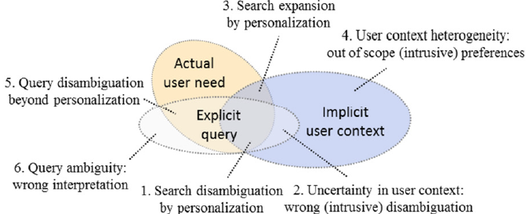
Introduction
Goal：we question this antagonistic view, and hypothesize
that these two directions may in fact be effectively combined and
enhance each other.

Slide 6
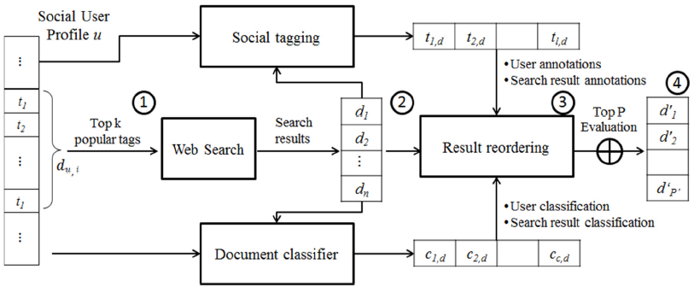
Introduction

Slide 7
Outline
Introduction
Personalized Diversity
IA-Select、xQuAD
Personalized IA-Select
Personalized xQuAD
Evaluation
Experiment Results
Conclusions

Slide 8
IA-Select、xQuAD
using an explicit representation of query intents for diversification.
IA-Select:
xQuAD(eXplicit Query Aspect Diversification):

Slide 9
Personalized IA-Select
• A personalized search system: p(q|d,u)
• The personalized query aspect distribution: p(c|q,u)
• The personalized aspect distribution over documents: p(c|d,u)
p(q|d,u)
assume q and u are conditionally independent given a document
= Position of document d in the order induced by the retrieval system scores s(d,q) for d∈ Rq

Slide 10
p(c|d,u)
assume conditional independence between documents and users given a query aspect
assume conditional independence between aspects and users given a document.

Slide 11
Two ways to calculate p(d|u):
1. User preference model by an adaption of the BM25 probabilistic model：
b = 0.75
k1 = 2
2.
iuf(w) : the inverse user frequency of term w in the set of users.
|u| : the size of the user profile calculated as Σwtf(w,u).
w : a tag in the folksonomy(Delicious)
tf(w,u) :the number of times a user used the tag in their profile bookmark annotations.
tf(w,d) :number of times a tag was used (by any user) to annotate a document.
Δ = document collection

Slide 12
p(c|q,u)
A convenient one is to develop p(c|q,u) by marginalizing over the set of documents, because it allows taking advantage of the computation of the two previous top-level components in equations 1 and 2
assume the conditional independence of query aspects and queries given a user and a document.

Slide 13
Personalized xQuAD
• The personalized search system: p(q|d,u)
• The personalized query aspect distribution: p(c|q,u)
• The personalized, aspect-dependent document distribution: p(d|c,u)
p(d|c,u)
assumed documents and users are conditionally independent given a query aspect.
P(c|d): by Textwise ODP classification service. It returns up to three possible ODP classifications for a document, ranked by a score in [0,1] that reflects the degree of confidence on the classification.

Slide 14
Outline
Introduction
Personalized Diversity
IA-Select、xQuAD
Personalized IA-Select
Personalized xQuAD
Evaluation
Experiment Results
Conclusions

Slide 15
Evaluation
Crowdsourcing service :Amazon mechanical turk, Crowdflower
Data set : Delicious
Assessment collection : four weeks
Tested user number : 35 users
for a total amount of 180 topics and 3,800 individual results.
randomly generated an equal amount of topics of size K = 1 and K = 2
top P = 5

Slide 16
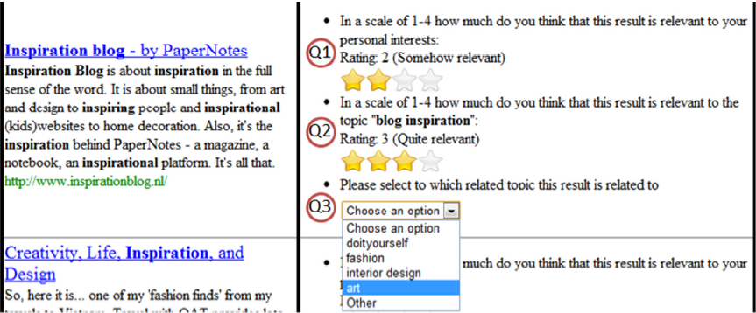
Evaluation
interactive evaluation interface

Slide 17
Evaluation
• Q1 (user): how relevant is the result to the user’s interests.
• Q2 (topic): how relevant is the result to the evaluated topic.
• Q3 (subtopic): workers assign each result to a specific subtopic related
to the evaluated topic.
Q1 measuring the accuracy of the evaluated approaches with respect to the user interest.
Q2 : a successful reordering technique will place results high that are assessed as both relevant to the topic and to the user’s interests.

Slide 18
Outline
Introduction
Personalized Diversity
IA-Select、xQuAD
Personalized IA-Select
Personalized xQuAD
Evaluation
Experiment Results
Conclusions

Slide 19
Experiment Results
Nine different approaches :
Baseline
IA-Select
xQuAD
plain personalized search approach based on social tagging profiles and BM25 (PersBM25)
xQuADBM25
PIA-Select (probabilistic calculation of p(d|u))
PIA-SelectBM25 (BM25 of p(d|u))
PxQuAD
PxQuADBM25

Slide 20
Experiment Results
to evaluate for diversity :
the intent aware version of expected reciprocal rank (ERR-IA), α-nDCG , and subtopic recall (S-recall)
for accuracy :
nDCG and precision

Slide 21
α-nDCG
 | C1-1 | C1-2 | C1-3
D1
D2
D3
D4
α = 0.5

Slide 22
IG:
ICG:
IDCG:
α-nDCG:

Slide 23
Subtopic recall(S-recall)
topic T with nA subtopics
subtopics(di) be the set of subtopics to which di is relevant.
T
s1,s2,s3,s4,s5,s6,s7,s8,s9,s10
 | Subtopics(di)
D1 | s1,s3,s10
D2 | s3,s4,s6
D3 | s2,s5
D4 | s2,s7,s9
S-recall(1) = 3/10
S-recall(2) = 5/10
S-recall(3) = 7/10
S-recall(4) = 9/10

Slide 24
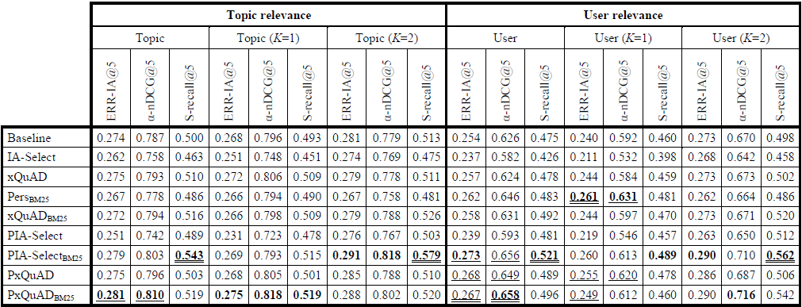
Diversity metric values for the evaluated approaches
Bold : the best for each metric.
Underlined : a statistically significant difference with respect to the baseline
Double underlined : a statistical significance with respect xQuAD (Wilcoxon, p < 0.05).
PxQuADBM25 has a significantly better performance than the baseline and plain diversification approaches in terms of ERR-IA and α-nDCG@5.
a negative effect of the probabilistic estimate of the personalized factor on the overall behavior of the PIA-Select algorithm.

Slide 25
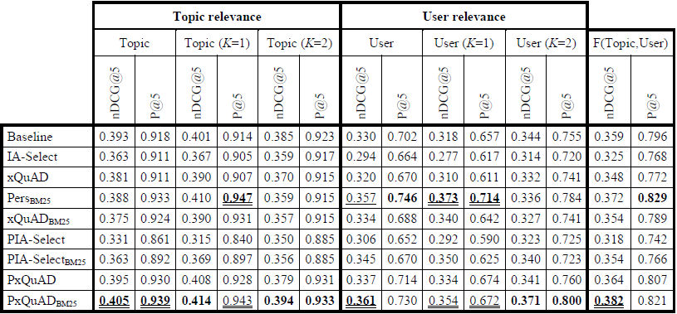
Accuracy metrics for evaluated approaches
User relevance : PersBM25,appears to be on par with PxQuADBM25
Topic relevance : PersBM25 underperforms the baseline , while PxQuADBM25
improves the baseline to this regard, with statistical significance.

Slide 26
Outline
Introduction
Personalized Diversity
IA-Select、xQuAD
Personalized IA-Select
Personalized xQuAD
Evaluation
Experiment Results
Conclusions

Slide 27
Conclusions
have presented a number of approaches that combine both personalization and diversification components
investigating the introduction of the user as an explicit random variable in two state of the art diversification models: IA-Select and xQuAD
Achieving statistically significant improvements over the baselines that range between 3%-11% in terms accuracy values, and between 3%-8% in terms of diversity values.

